Slide 1
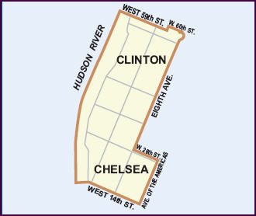
Manhattan Community Board 4
By: Tammoya Moore
Email: Tammoyamoore@gmail.com

Slide 2

CB 04 Assumptions of 311 Seasonal Data
Winter- construction, heating, snow
Fall - Trash, noise
Summer- Rodents, noise,
Spring- Noise, rodents, traffic

Slide 3
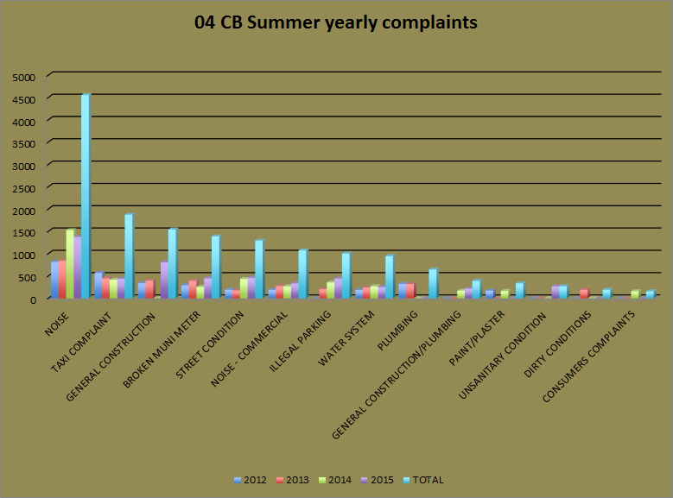
Summer 311 Complaints 2012-2015

Slide 4
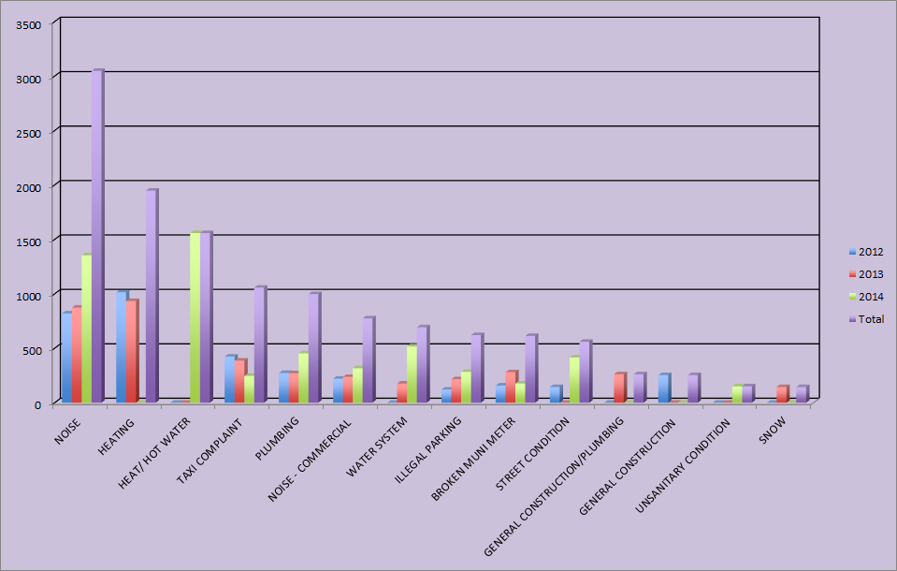
Winter 311 Complaints 2012-2015

Slide 5
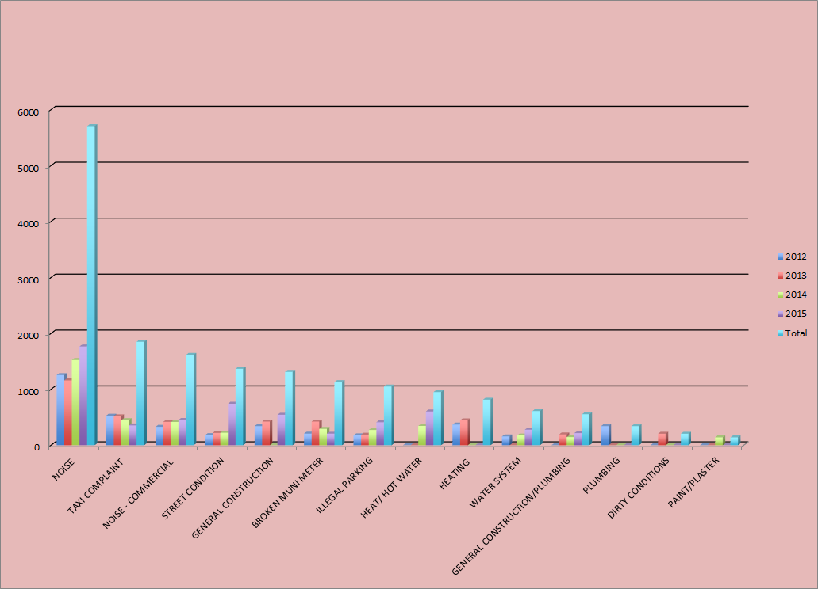
Spring 311 Complaints 2012-2015

Slide 6
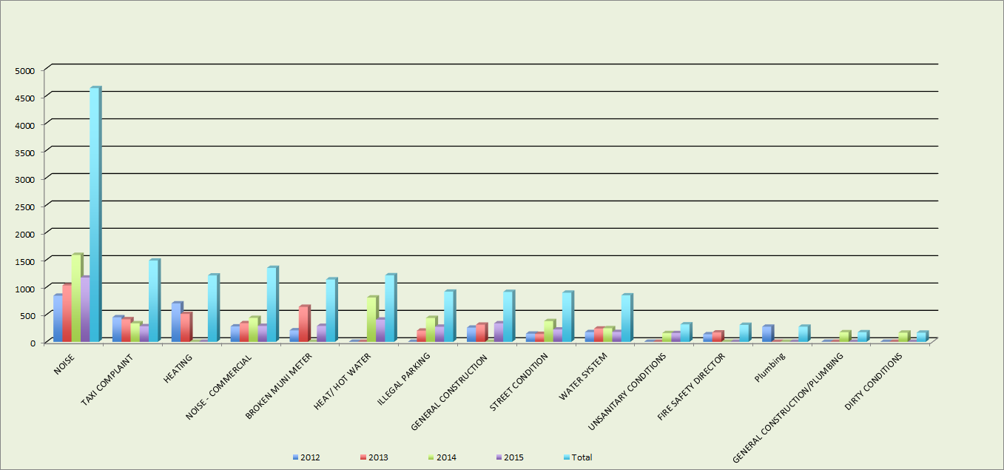
Fall 311 Complaints 2012-2015

Slide 7

Accuracy Of Assumption
After reviewing the 311 data of all seasons it became apparent that noise is definitely an issue.
I was very surprised that taxi complaints ranked 2nd for all seasons except Winter.
I found it very questionable that their wasn’t any rat complaints within the 311 data I’m very curious to know why might this be possible.

Slide 8

Winters Of 2014 and 2013
Differences: 2013- Snow 2014- Unsanitary conditions
Street Conditions 2013= 0 Complaints 2014= 416 Complaints
I believe that during the Winter of 2015, there is going to be a lot of complaints about heat and snow, street conditions. Especially since each year the winters are getting worse in terms of weather and Temp.

Slide 9
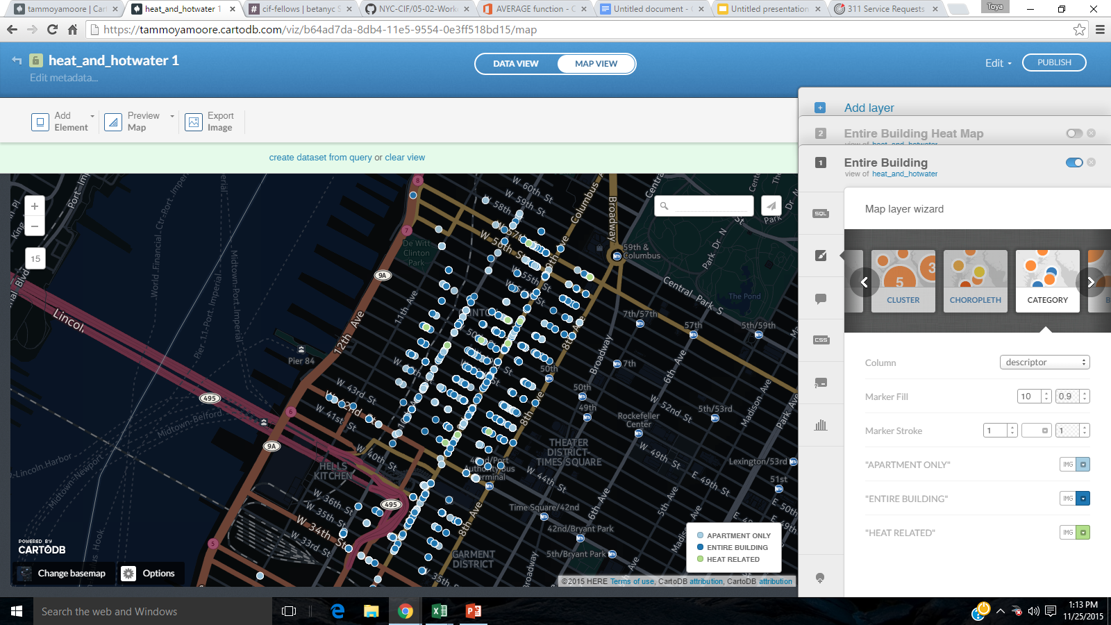
Heat and Hot Water
The months with the most heat and Hotwater service request:
November
January
December
https://tammoyamoore.cartodb.com/viz/b64ad7da-8db4-11e5-9554-0e3ff518bd15/map

Slide 10
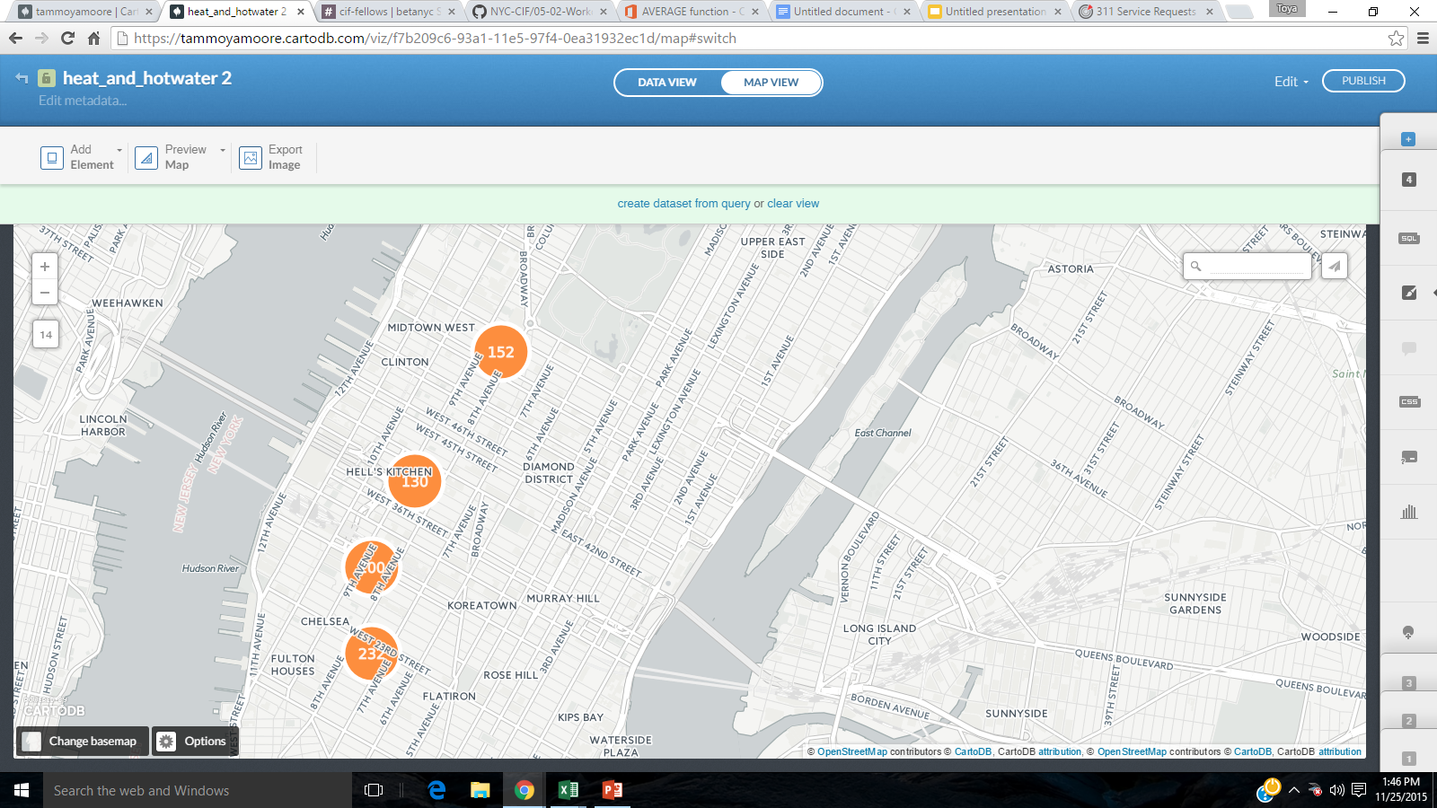
Heat and Hot Water
Repeated callers: 216 west 23 street (232) 324 west 30 street (200) 859 9 avenue (152) 351 west 42 street (130)
https://tammoyamoore.cartodb.com/viz/f7b209c6-93a1-11e5-97f4-0ea31932ec1d/map#switch

Slide 11
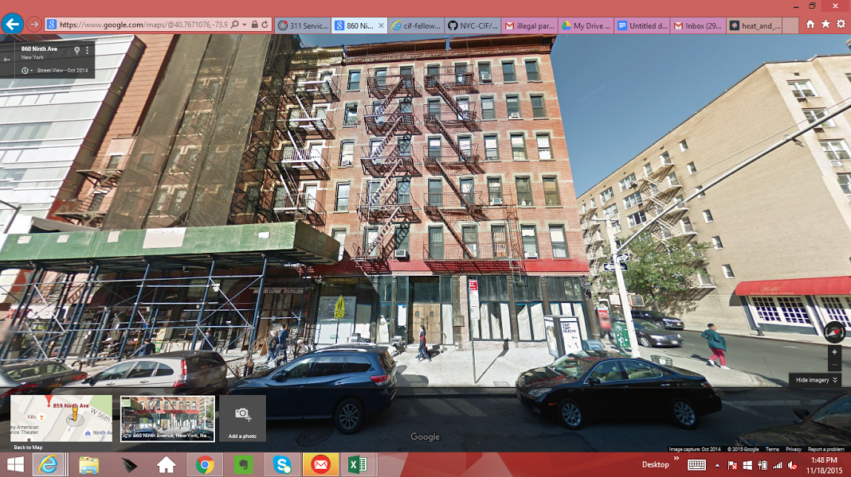
Entire Building: 859 Ninth Avenue New York
859 Ninth Avenue New York, NY 10019
Built 1883, 6 stories tall, 44 apartments
Managed by David Svitic
January 2015, there have been many complaints on Apartable.com:
*The building manager claims these issues
were resolved. However, recently in October and
November 2015 there have been more updated complaints issued by 311 dataset.
http://apartable.com/buildings/859-9-avenue-manhattan

Slide 12
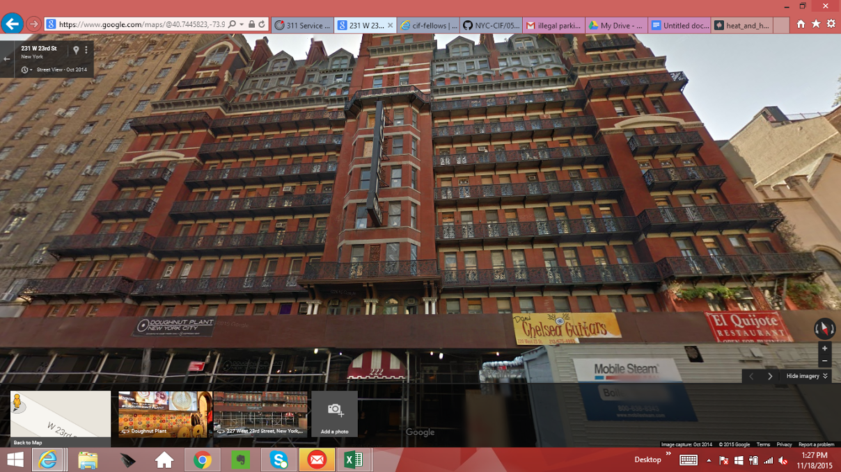
Entire Building: 216 west 23 street
216 west 23 street New York, NY 10011 · Chelsea
Built 1883, 250 units, 10 apartment
There have been a great amount of complaints as well from January- Feb 2015. *After checking the 311 datasets there haven’t been any recent complaints since then.
http://apartable.com/buildings/216-west-23-street-manhattan

Slide 13
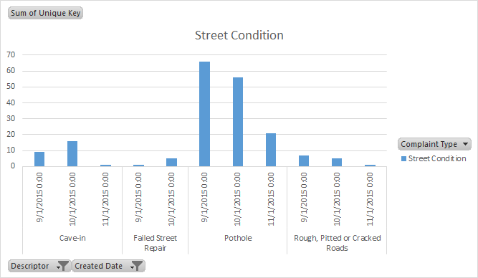
Street Condition
Top 4 complaints within 60 days:
Pothole
Cave-in
Failed Street Repair
Rough,Pitted or Crack Roads
*Potholes for the past 3 months have the main complaint that people are having compared to other complaints.
*The graph shows that cave -in was at its peak in October, however, the complaints decreased in November.

Slide 14
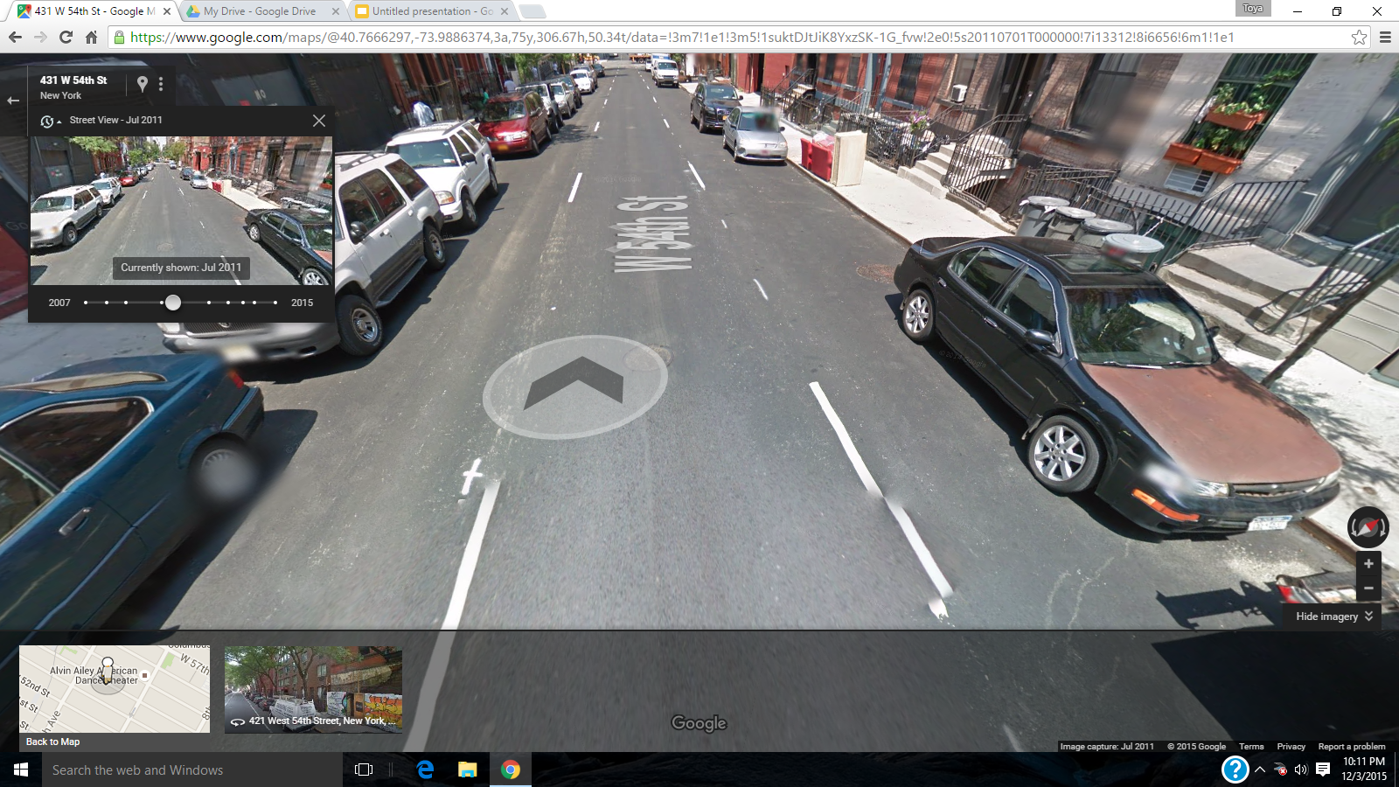
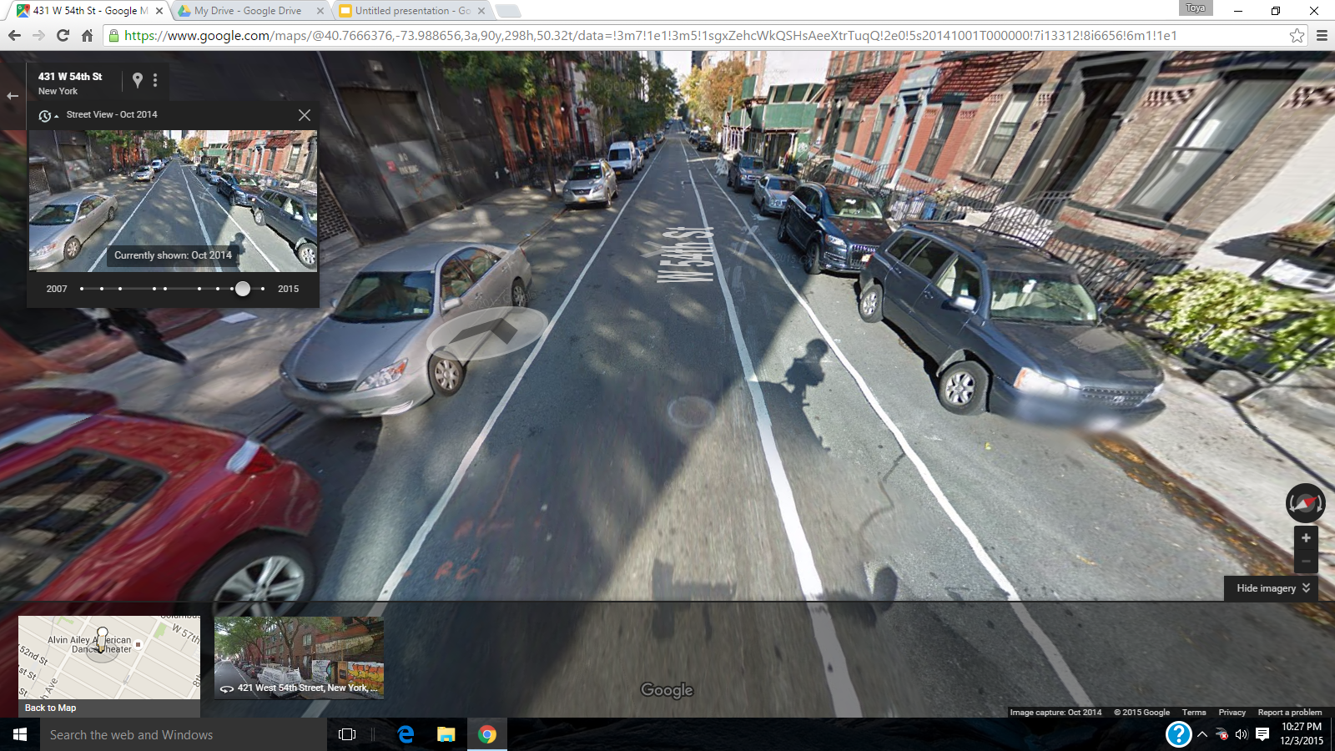
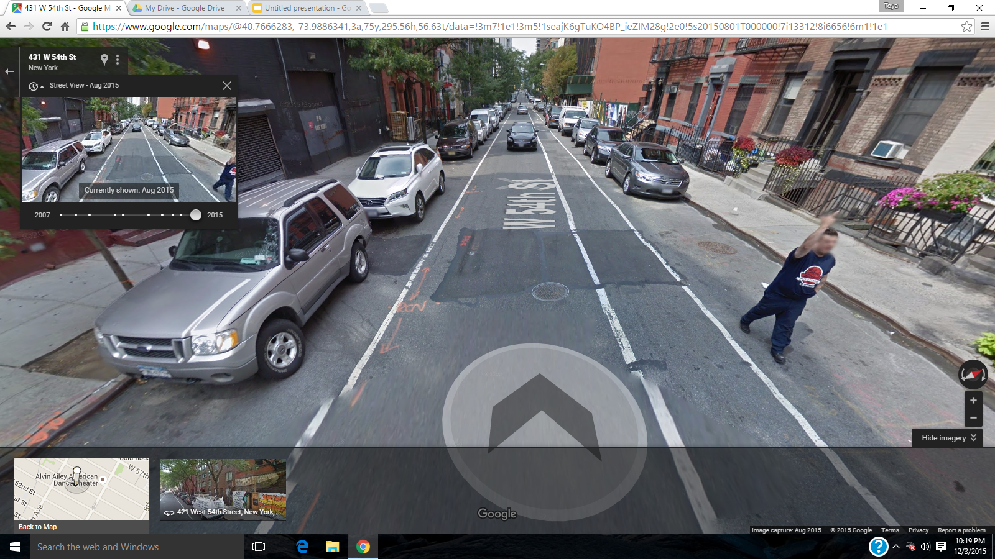
Repeated Callers: 421 W 54th St, New York, NY 10019
July 2011 Oct 2014 Aug 2015

Slide 15
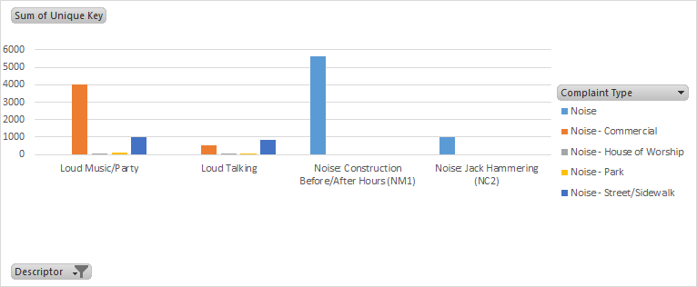
Noise
Top 4 Noise complaints:
Loud Music/ Party - A lot of complaints for commercial noise,house of worship (noise), street/sidewalks (noise).
Loud Talking- commercial noise, street/sidewalks (noise).
Noise Construction - Noise
Noise Jack Hammering- Noise

Slide 16
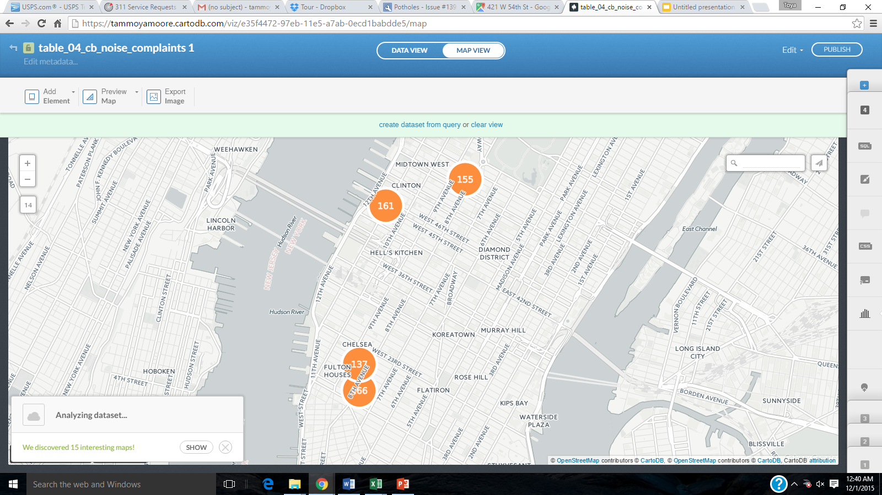
Noise: Hot Spots
Hotspot Locations: h
355 west 16 street (166)
514 west 44 street (161)
939 8 avenue (155)
174 8 avenue (137)
https://tammoyamoore.cartodb.com/viz/e35f4472-97eb- 11e5-a7ab-0ecd1babdde5/map

Slide 17
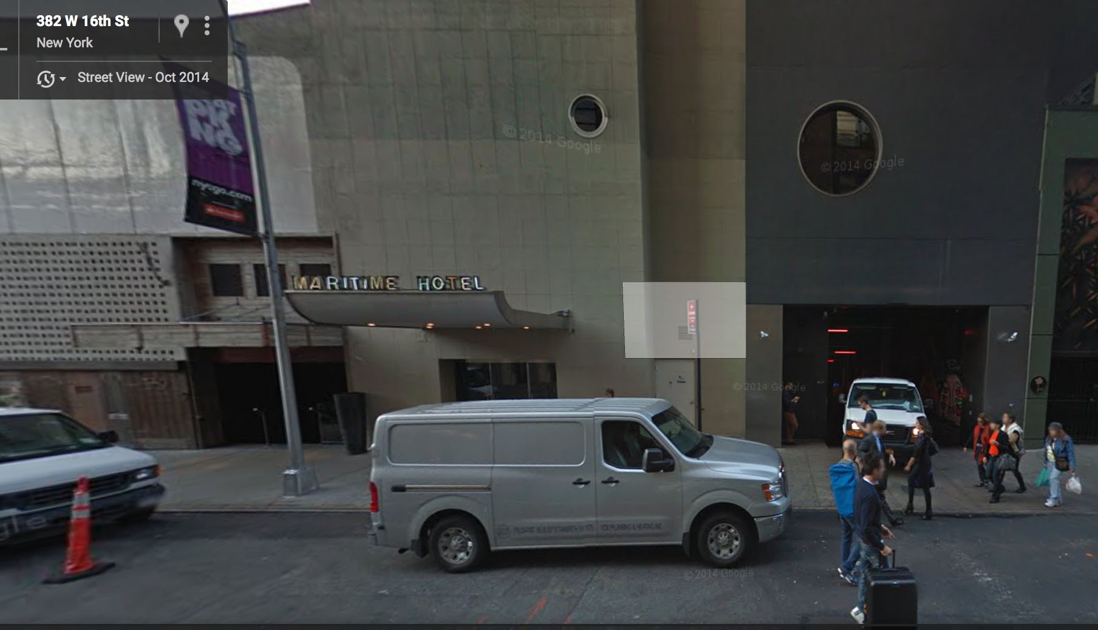
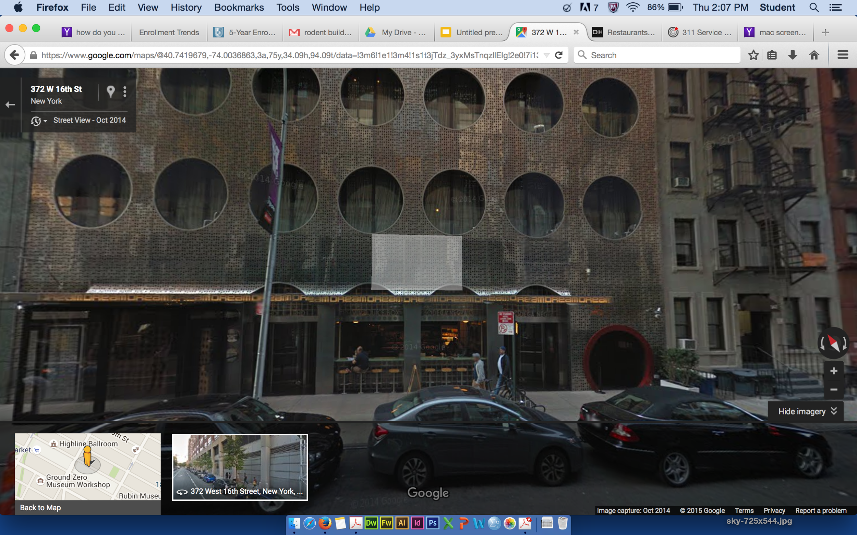
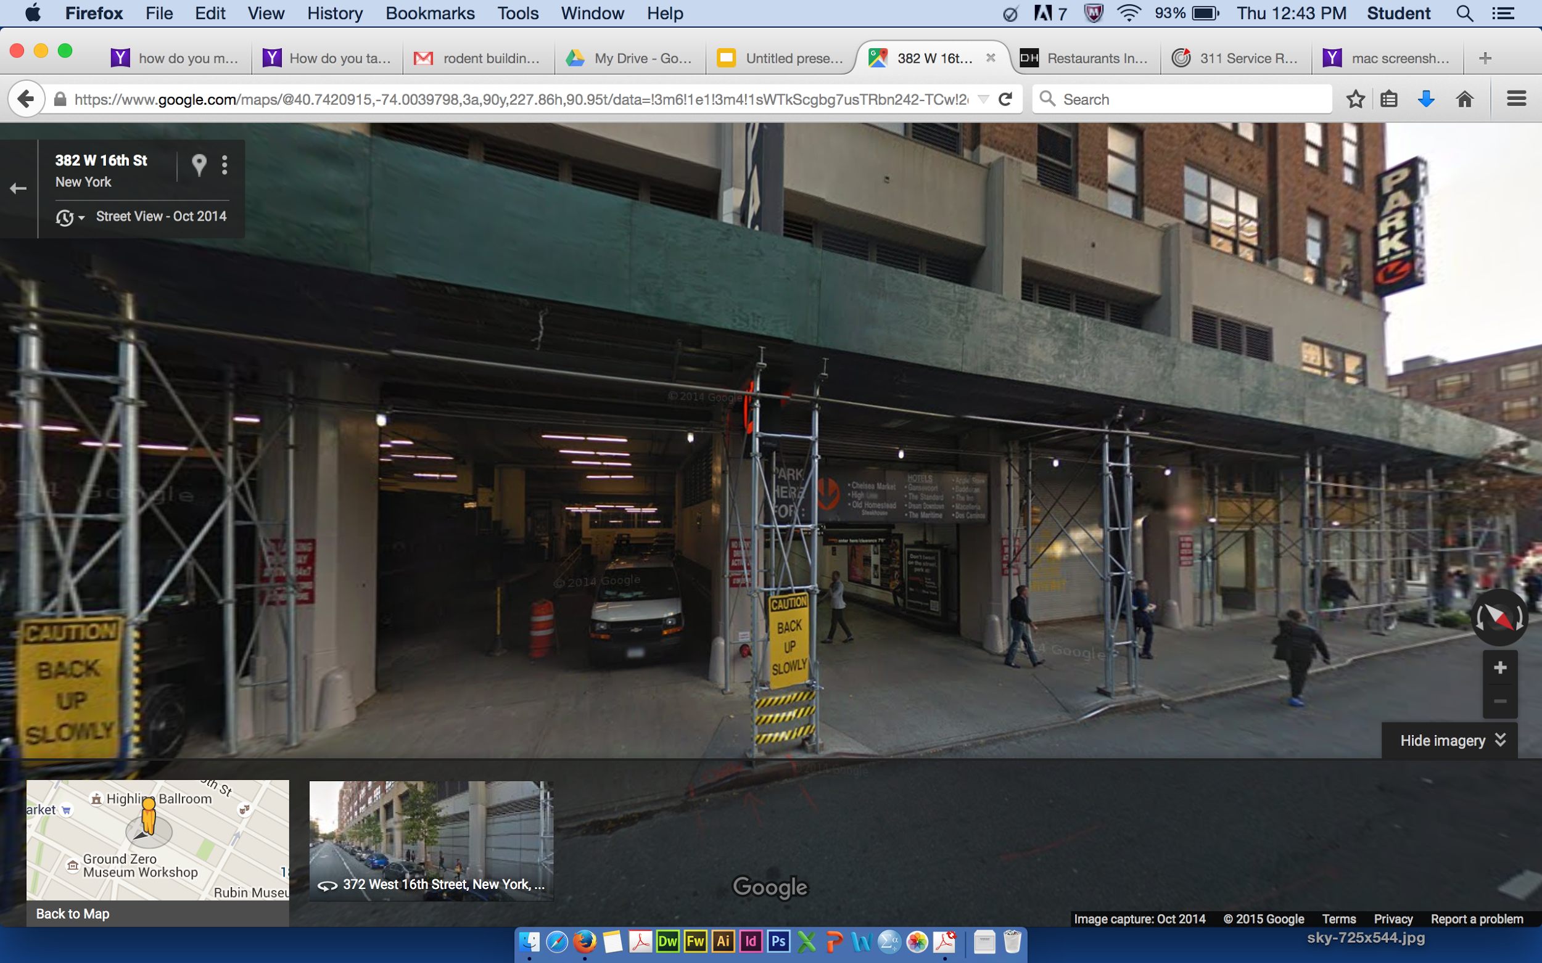
Noise: 355 west 16 street
*In this location there is Maritime hotel and Dream Hotel. Dream hotel is very popular for it’s open bars and clubs (Electric Room)
Complaints: People created noise
Complaints:
Truck Horns, and Truck Music
Complaints:Loud music and parties

Slide 18
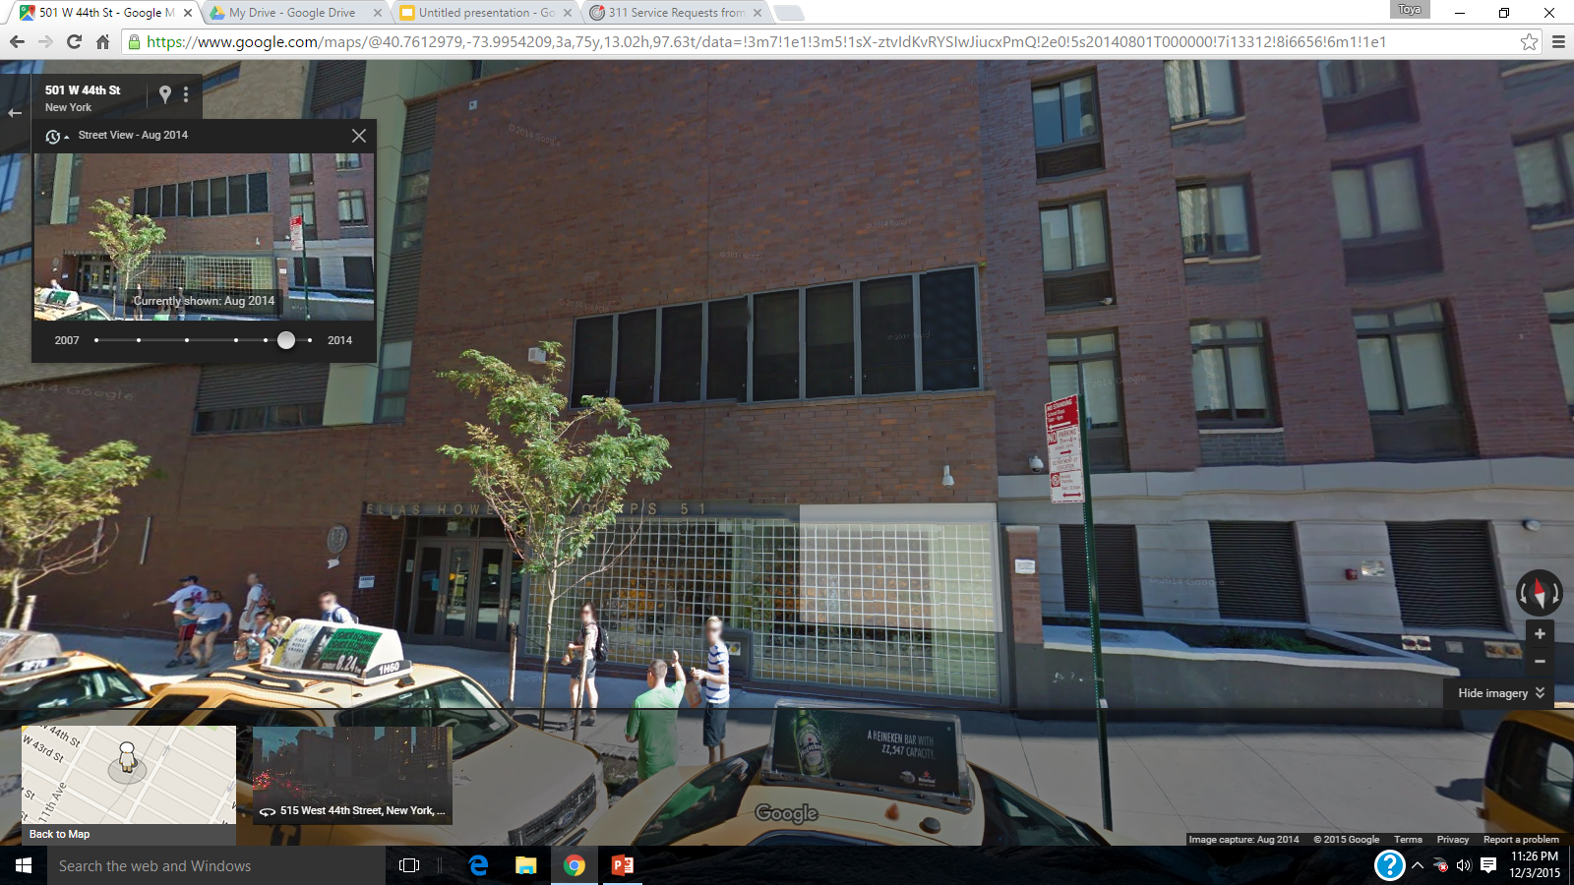
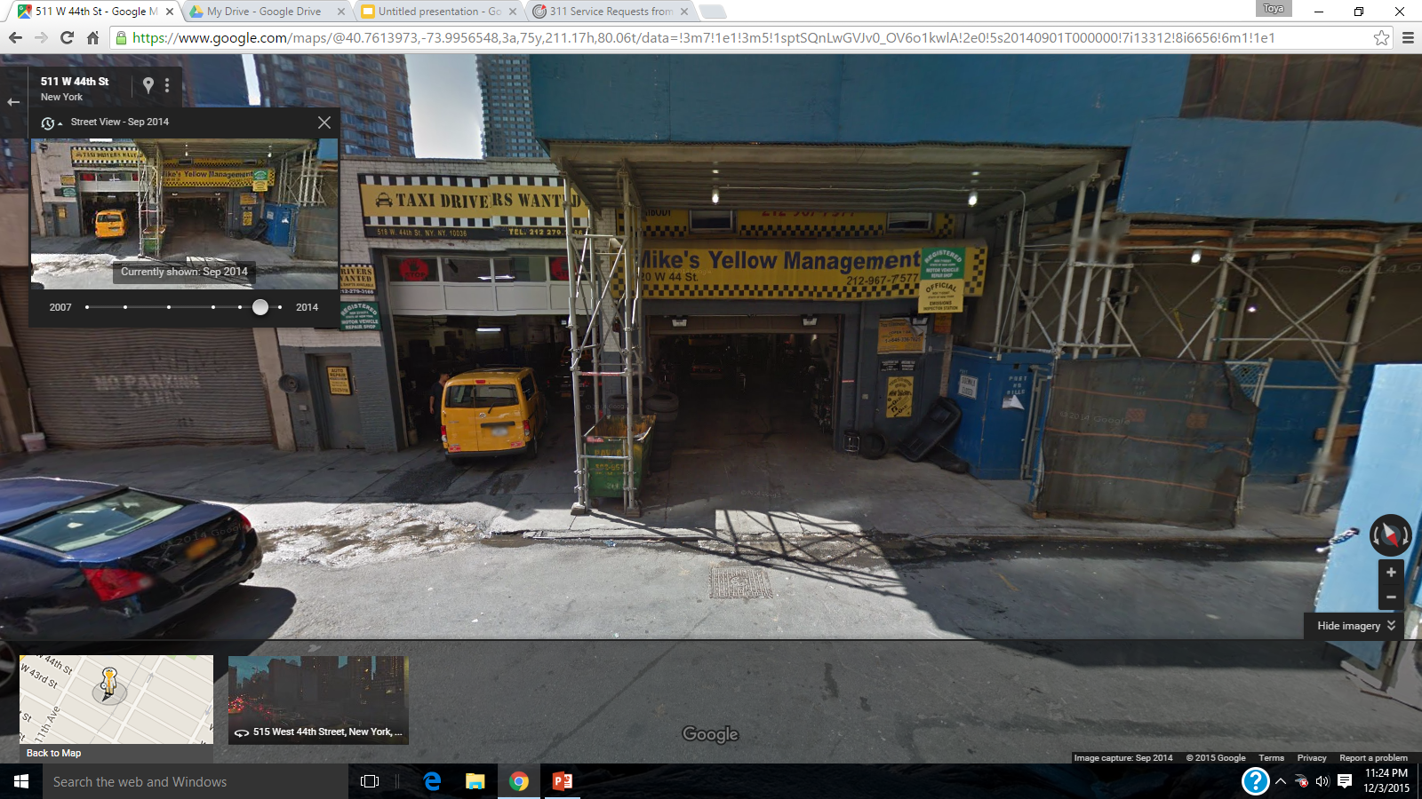
Noise: 514 west 44 street
*Complaints:
-Car/Truck (Horn,Music)
-Loud Music and Loud Talking
-Loud banging noise
School
Taxi station

Slide 19
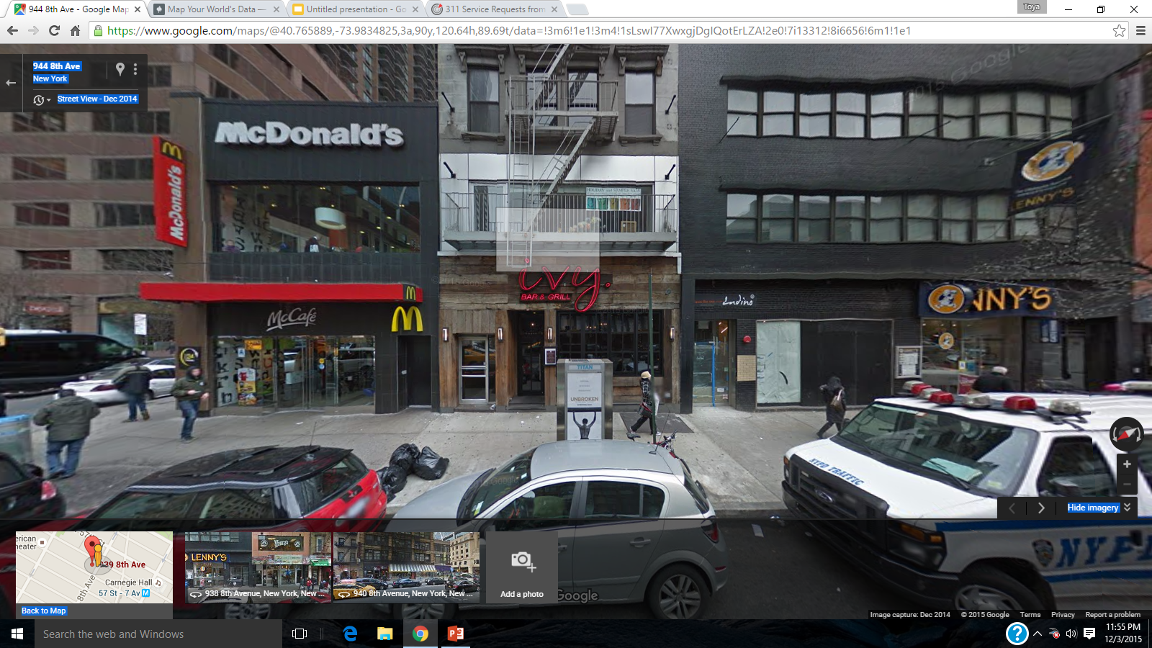
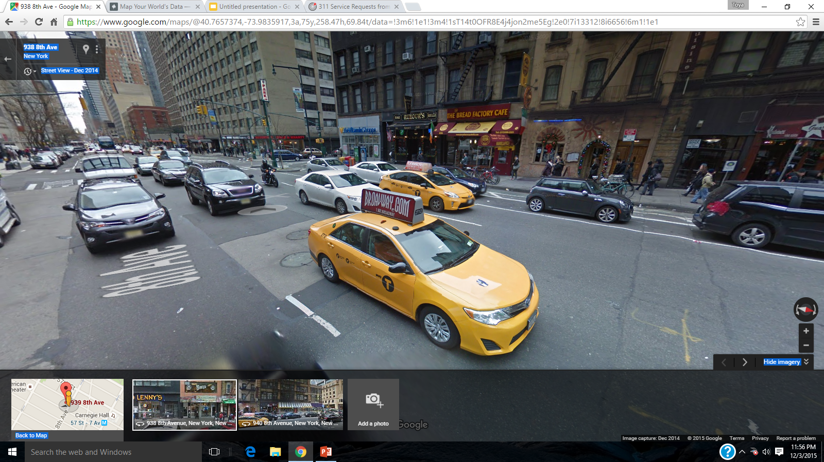
Noise: 939 8 avenue
*Complaints:
- Loud Music and Party
- Car/ truck music
Busy Street
Bars/ fast food spots

Slide 20
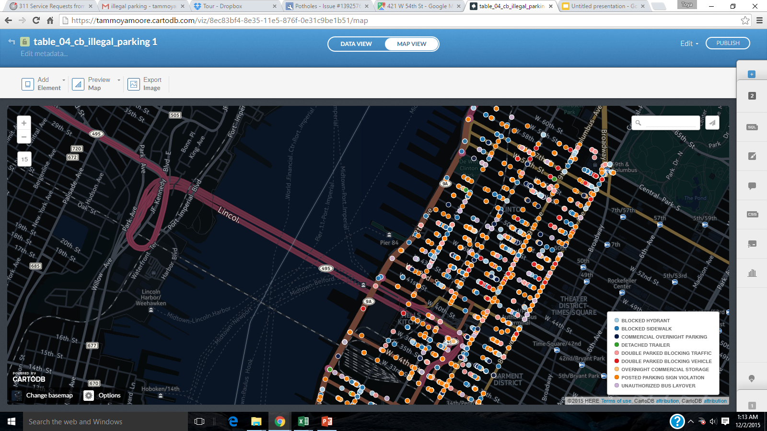
Illegal Parking
Months with the most illegal parking Complaints:
August
September
April
May
*The more warmer it gets or milder the temperature, more people are driving and finding it hard to find parking.

Slide 21
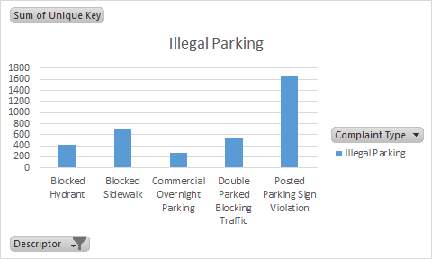
Illegal Parking
Top 5 Illegal parking complaint:
Blocked Hydrants
Blocked Sidewalk
Commercial Overnight Parking
Double Parking Blocking Traffic
Posted Parking Sign Violations

Slide 22
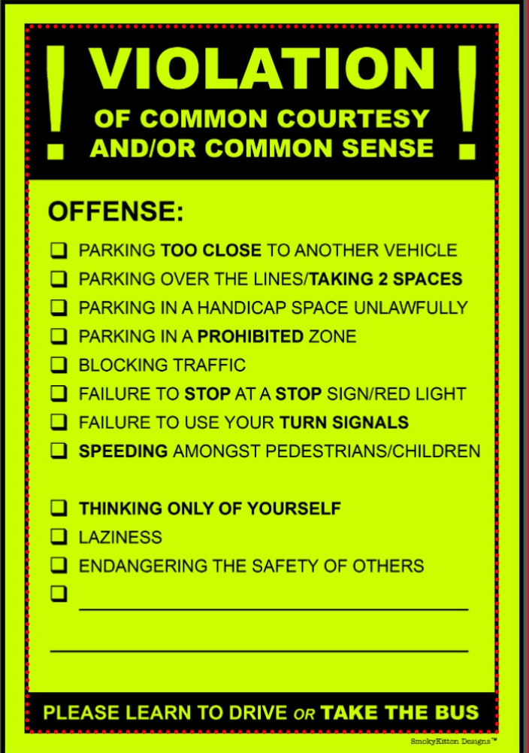
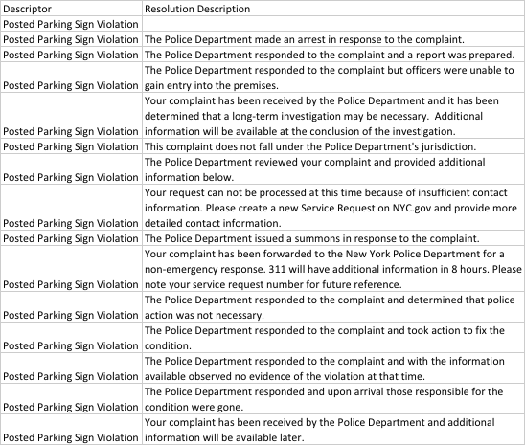
Illegal Parking: Posted Parking Sign Violations
Hotspot Locations:
502 West 44 street
511 West 44 street
504 West 44 street
Resolution descriptions:
The Police Department was involved and even made an ARREST for this particular issue.

Slide 23

Rodents
After reviewing the 311 data I found it very interesting since there was very little percentage of rodent complaints in CB 4.
I then took it upon myself to do little research to see why this might be possible. I began to wonder if CB 4 is cleaner in the sense of maintenance, since rodents are a huge problem for many other NYC community board locations.

Slide 24
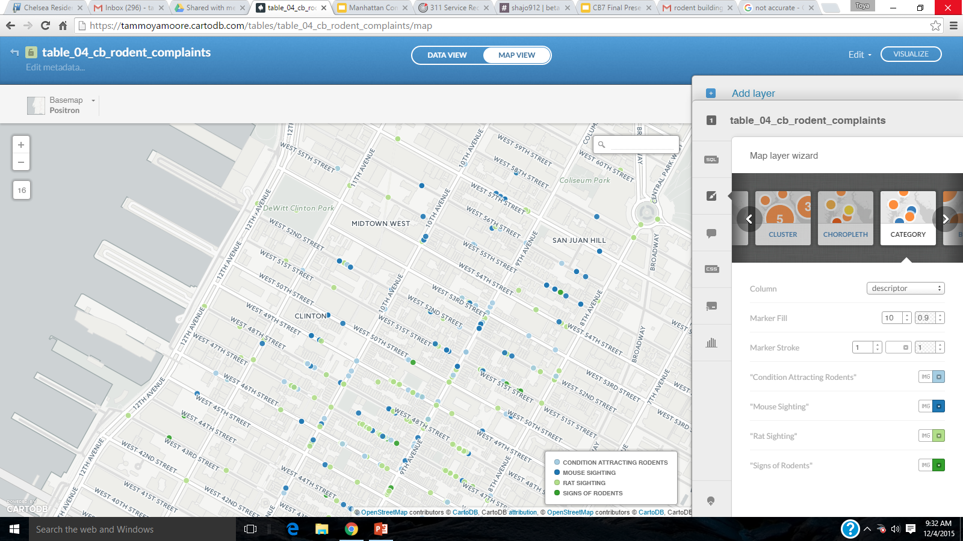
Rodents
Hotspot Locations:
454 west 47 street
456 west 47 street

Slide 25
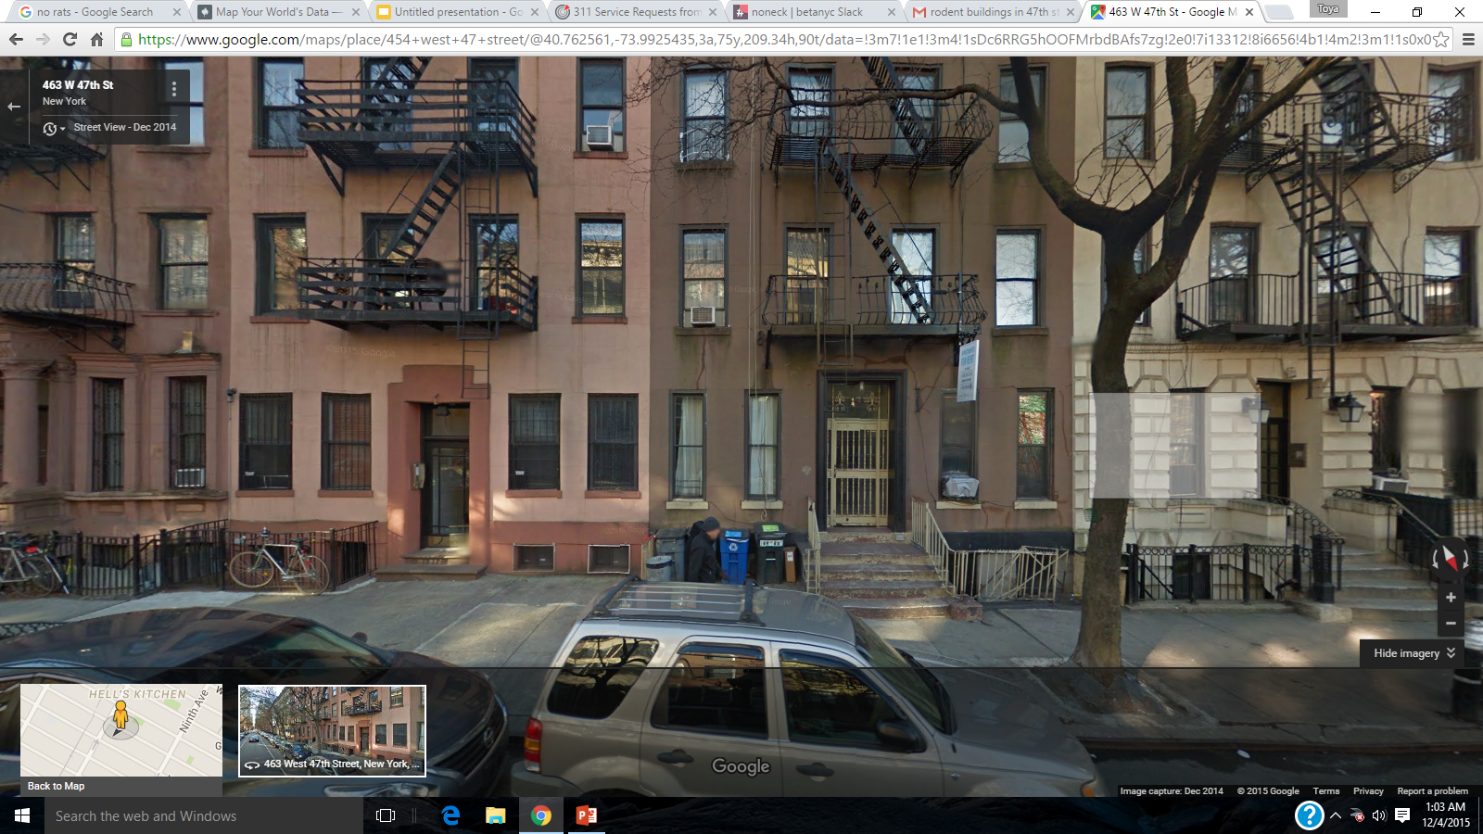
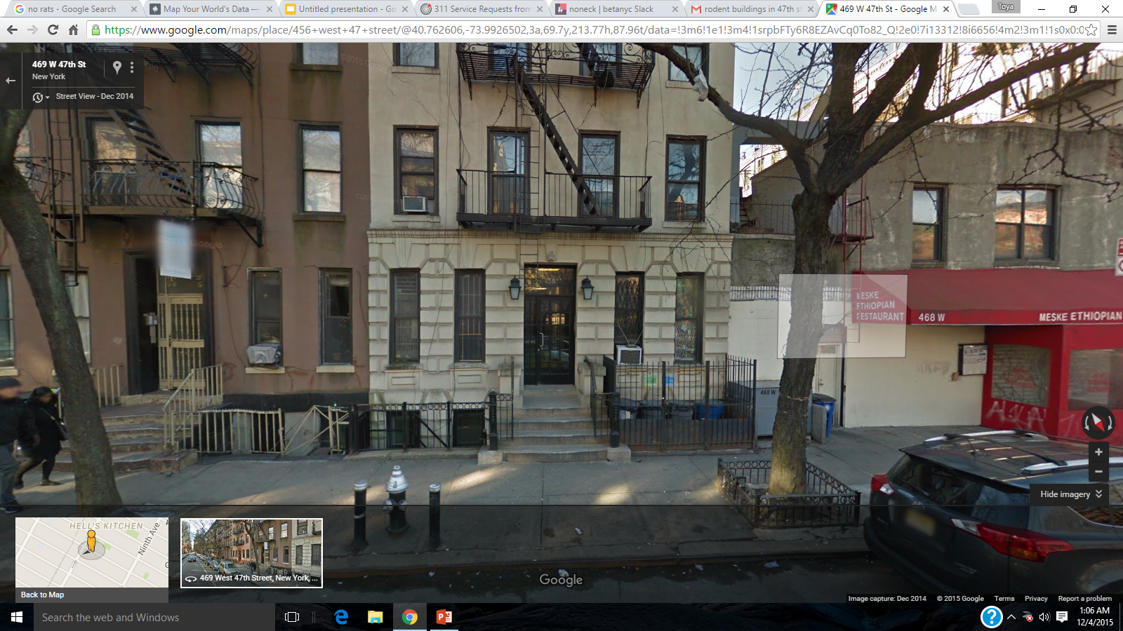
311 Rodent Hotspots
454 west 47 street
456 west 47 street

Slide 26
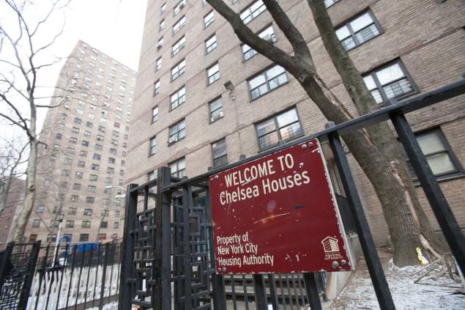
Chelsea Residents Complain of Growing 'Rat Academy' in Neighborhood
Recently in July 28,2015 there have been complaints by residents of Chelsea area about the growing number of rodents in their neighborhood. (Elliot Chelsea Houses Greenwich village, Hell’s Kitchen)
The rodents described to be as big as cats, feeding from their garbages.
Rats are now becoming a common sight. Preventing people from wanting to garden since they’re eating their plants.
http://www.ny1.com/nyc/manhattan/news/2015/07/28/chelsea-residents-complain-of-growing--rat-academy--in-neighborhood.html

